Slide 1
ADAPTIVE SYSTEMS (UE17EC346)
PAPER ON :
A SYSTEM THEORY CRITERION FOR POSITIVE REAL MATRICES
BY – B. D. O. ANDERSON (1967)
Report By : Ratan Gundami
PES1201701556

Slide 2
Introduction
The concept of a positive real function is a vast and important topic in network theory. But due to some applications of positive real function in the control systems theory, it seems possible that this concept can be employed in control systems investigation.
The main aim of the paper is to develop a system theoretic criterion of a matrix, which is formulated in terms of the parameters of a control system realization of matrix.
Before proceeding to the final theorem, a couple of theorems have been derived for a sub-class of the generalized theorem. These theorems motivate in the development of the 3rd i.e. more generalized theorem.
These theorem are derived with the help of several preliminary concepts such as Minimal realizations, Spectral factorization, Lyapunov’s direct method, etc. These preliminary concept are revised are several Lemmas and the some Lemmas are derived according to our need derive the theorems

Slide 3
Literature Review
For the ease, we will divide our review into 3 parts as follows:
Preliminary concepts and their background.
Proofs of some Lemmas which will form basis of derivation of Theorems
3 Theorems which describe the criterion of positive real matrices.
Z(s)
No imaginary poles
Z($∞$) = 0 (Strictly proper)
(THEOREM 1)
No imaginary poles
Z(∞) = 0 (Strictly proper)
(THEOREM 1)
Pure imaginary poles
Z($∞$) = 0 (Strictly proper)
(THEOREM 2)
Pure imaginary poles
Z(∞) = 0 (Strictly proper)
(THEOREM 2)
General Transfer Function
Z($∞$) is finite (Proper)
(THEOREM 3)
General Transfer Function
Z(∞) is finite (Proper)
(THEOREM 3)

Slide 4
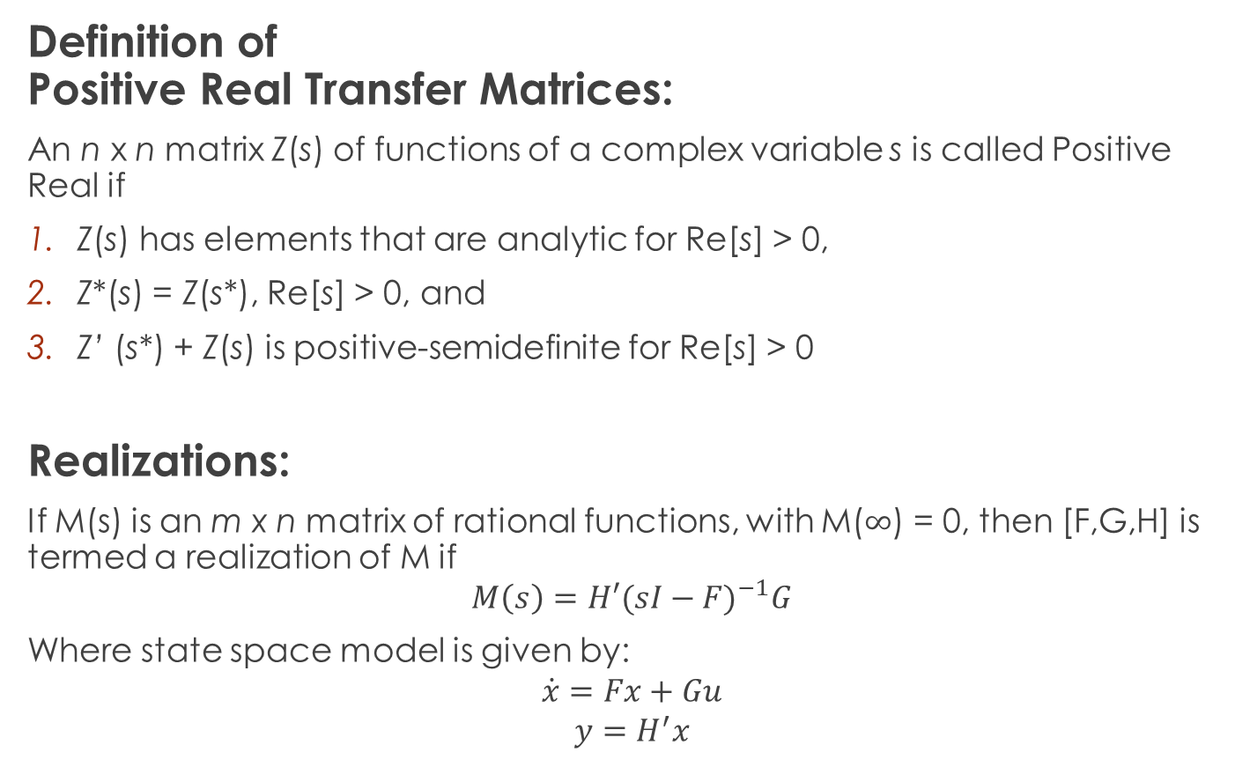
Part 1
Definition of Positive Real Transfer Matrices:
An n x n matrix Z(s) of functions of a complex variable s is called Positive Real if
Z(s) has elements that are analytic for Re[s] > 0,
Z*(s) = Z(s*), Re[s] > 0, and
Z’ (s*) + Z(s) is positive-semidefinite for Re[s] > 0
Realizations:
If M(s) is an m x n matrix of rational functions, with M($∞$) = 0, then [F,G,H] is termed a realization of M if
$$M\left(s\right)=H′{(sI−F)}^{−1}G$$
Where state space model is given by:
$$\dot{x}=Fx+Gu$$
$$y=H^{′}x$$

Slide 5
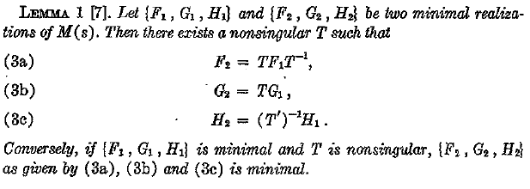
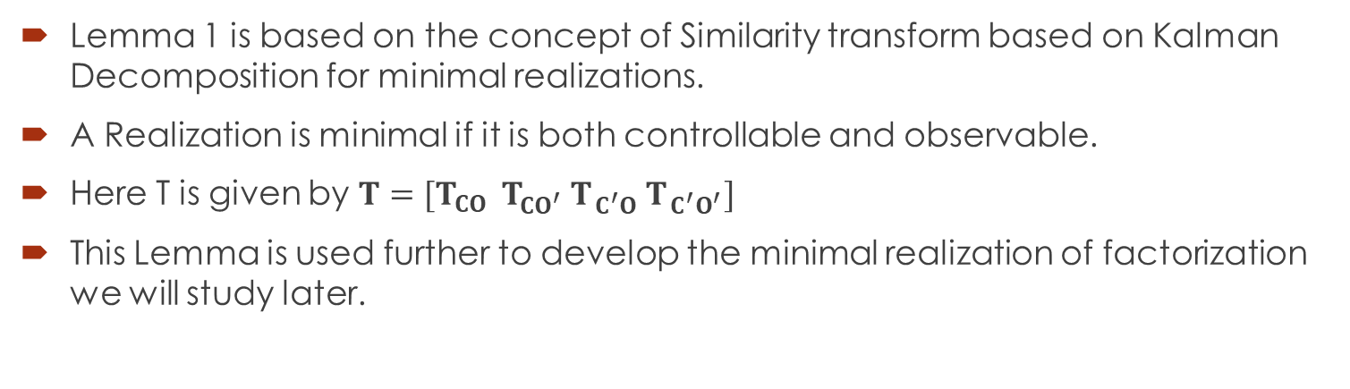
Lemma 1 is based on the concept of Similarity transform based on Kalman Decomposition for minimal realizations.
A Realization is minimal if it is both controllable and observable.
Here T is given by $T=[T_{CO } T_{CO^{′}} T_{ C^{′}O} T_{ C^{′}O^{′}}]$
This Lemma is used further to develop the minimal realization of factorization we will study later.

Slide 6
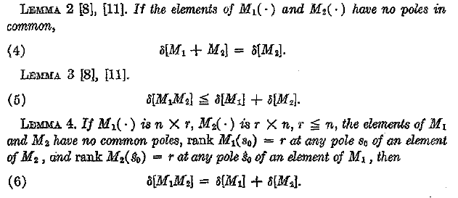

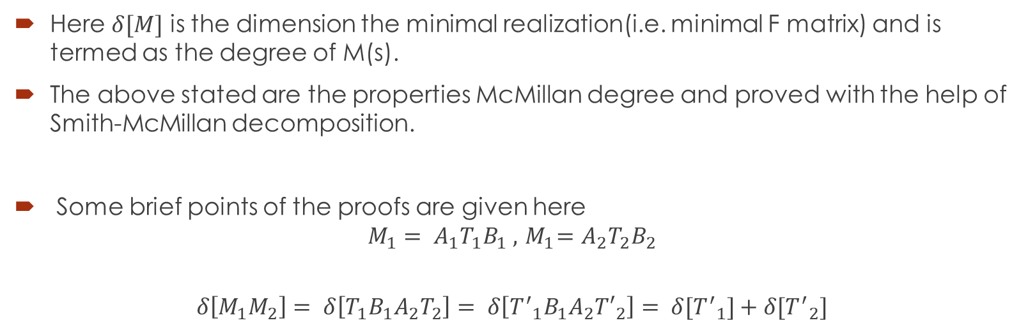
Here $δ[M]$ is the dimension the minimal realization(i.e. minimal F matrix) and is termed as the degree of M(s).
The above stated are the properties McMillan degree and proved with the help of Smith-McMillan decomposition.
Some brief points of the proofs are given here
$$M_{1}= A_{1}T_{1}B_{1} , { M}_{1}=A_{2}T_{2}B_{2}$$
$$δ\left[M_{1}M_{2}\right]= δ\left[T_{1}B_{1}A_{2}T_{2}\right]= δ\left[{T^{′}}_{1}B_{1}A_{2}{T′}_{2}\right]= δ[{T^{′}}_{1}]+δ[{T^{′}}_{2}]$$

Slide 7
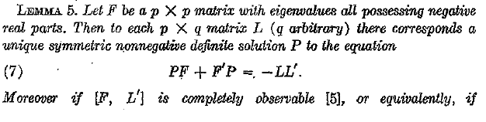
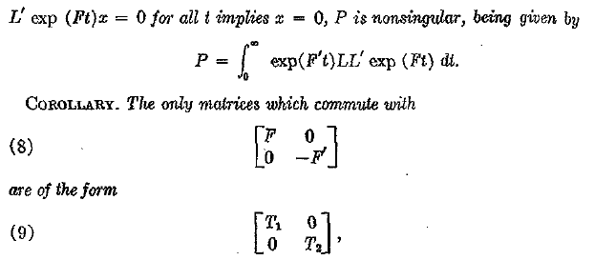

This is the straight application Lyapunov’s Direct method
We are going to use the corollary a lot in the future parts to derive most of our results.

Slide 8
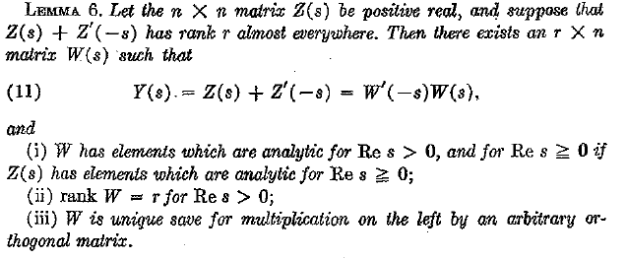
This proof is based on Spectral Factorization. Here Y(s) is para Hermitian.
Even this proof is derived based on the concepts of Smith McMillan decomposition.
This is the theorem present in D.C Youla’s “On the factorization of Rational matrices” .
This Lemma is the most important one we will use to further derive 2 more Lemma’s which will help in deriving the theorems.

Slide 9





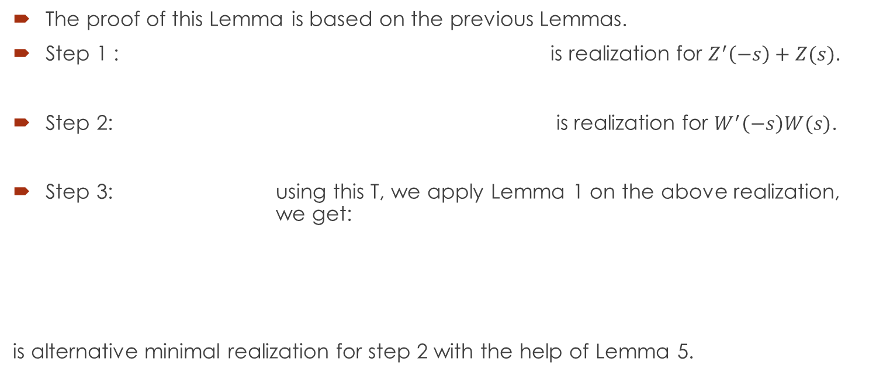
Part 2
The proof of this Lemma is based on the previous Lemmas.
Step 1 : is realization for $Z^{′}\left(−s\right)+Z(s)$.
Step 2: is realization for $W^{′}\left(−s\right)W(s)$.
Step 3: using this T, we apply Lemma 1 on the above realization, we get:
is alternative minimal realization for step 2 with the help of Lemma 5.

Slide 10
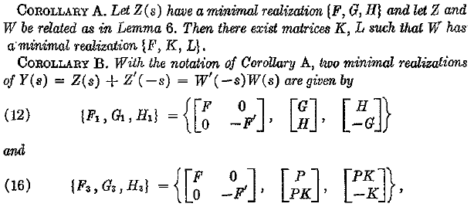
The proofs of these corollaries are derived with the help of Lemma 1.
Using these corollary we another Lemma which will make the realization of the factor(W) more relatable to Z

Slide 11


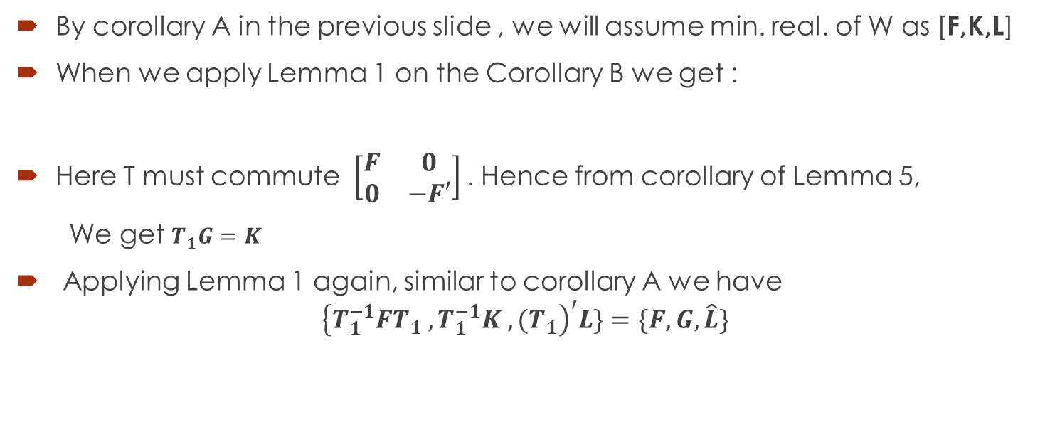
By corollary A in the previous slide , we will assume min. real. of W as [F,K,L]
When we apply Lemma 1 on the Corollary B we get :
Here T must commute $\left[\begin{matrix}F & 0 \\ 0 & −F′\end{matrix}\right]$. Hence from corollary of Lemma 5,
We get $T_{1}G=K$
Applying Lemma 1 again, similar to corollary A we have
$${\left\{T_{1}^{−1}FT_{1} ,T_{1}^{−1}K , {(T}_{1}\right)}^{′}L\}=\{F,G,\hat{L}\}$$

Slide 12

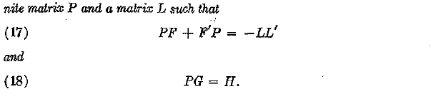
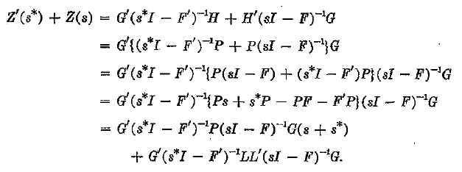

Part 3
For proof of sufficiency, only the 3 point of the PR definition needs to be proven, i.e. $Z^{′}\left(s^{∗}\right)+Z\left(s\right) is non−negative definite for Re s>0$

Slide 13


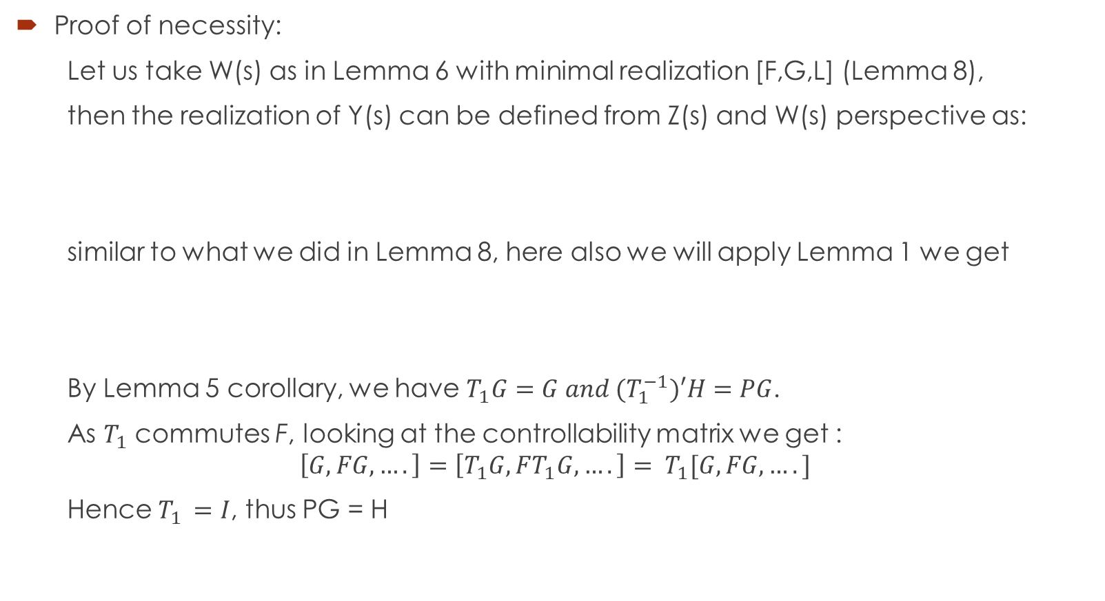
Proof of necessity:
Let us take W(s) as in Lemma 6 with minimal realization [F,G,L] (Lemma 8),
then the realization of Y(s) can be defined from Z(s) and W(s) perspective as:
similar to what we did in Lemma 8, here also we will apply Lemma 1 we get
By Lemma 5 corollary, we have $T_{1}G=G and {(T}_{1}^{−1})′H=PG$.
As $T_{1}$ commutes F, looking at the controllability matrix we get :
$$\left[G,FG,….\right]=\left[T_{1}G,FT_{1}G,….\right]= T_{1}[G,FG,….]$$
Hence $T_{1 }=I$, thus PG = H

Slide 14
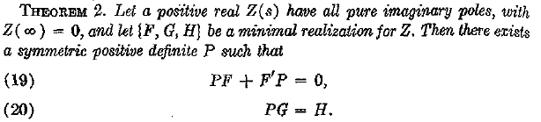





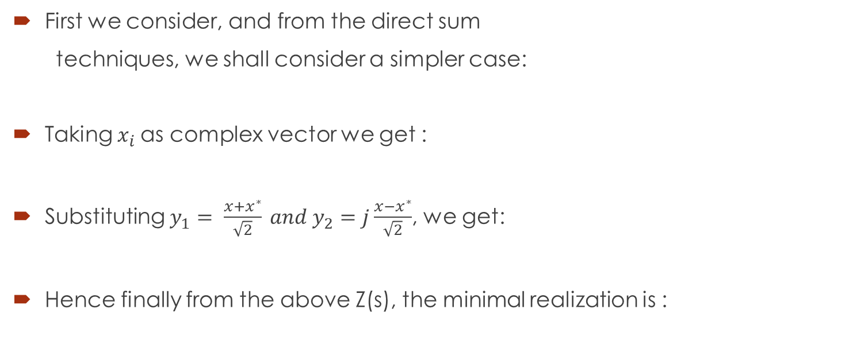
First we consider, and from the direct sum
techniques, we shall consider a simpler case:
Taking $x_{i}$as complex vector we get :
Substituting $y_{1}= \frac{x+x^{∗}}{\sqrt{2}} and y_{2}=j\frac{x−x^{∗}}{\sqrt{2}}$, we get:
Hence finally from the above Z(s), the minimal realization is :

Slide 15
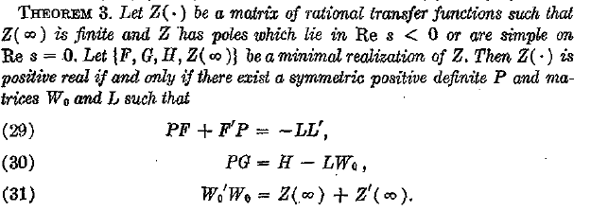



Any Positive real matrix can be written as a sum of Ds and Z(s), where D is semi-definite and Z(s) is also positive real, but with Z($∞$) finite, we wont lose generality in restricting the theorem statement to such Z(s)
Proof of sufficiency: We only have to verify that behaviour of Z’(s*)+Z(s) in the right half plane is positive real.

Slide 16
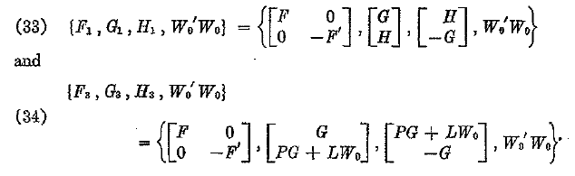
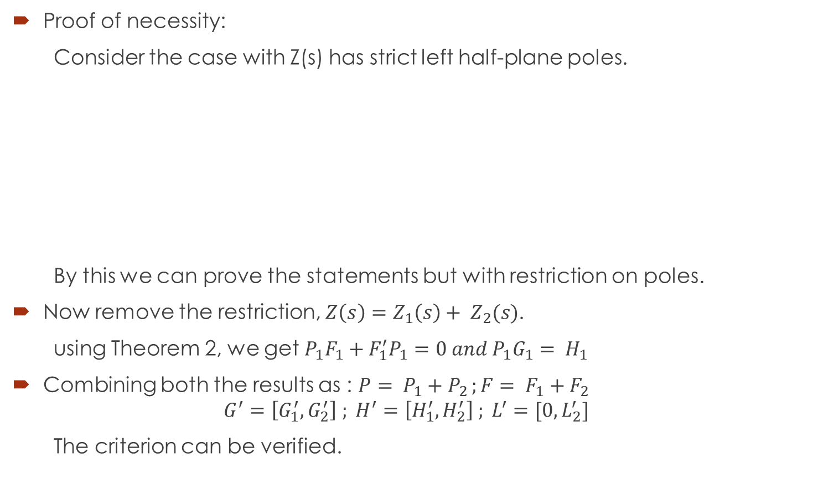
Proof of necessity:
Consider the case with Z(s) has strict left half-plane poles.
By this we can prove the statements but with restriction on poles.
Now remove the restriction, $Z\left(s\right)=Z_{1}\left(s\right)+ Z_{2}(s)$.
using Theorem 2, we get $P_{1}F_{1}+F_{1}^{′}P_{1}=0 and P_{1}G_{1}= H_{1}$
Combining both the results as : $P= P_{1}+P_{2 };F= F_{1}+F_{2}$
$$G^{′}=\left[G_{1}^{′},G_{2}^{′}\right] ; H^{′}=\left[H_{1}^{′},H_{2}^{′}\right] ; L^{′}=[0,L_{2}^{′}]$$
The criterion can be verified.

Slide 17
Conclusion:
This Criterion later came to be known as Positive Real(PR) Lemma. It provides a conceptual link between the Network theory and Control Theory.
This criterion solved the problem negative storage function problem, which was solved using only Nyquist criterion.
The one drawback of this criterion is that it is valid under a state space co-ordinate transformation, as they have merely been established for a particular class of F(of the form F1 + F2)

Slide 18
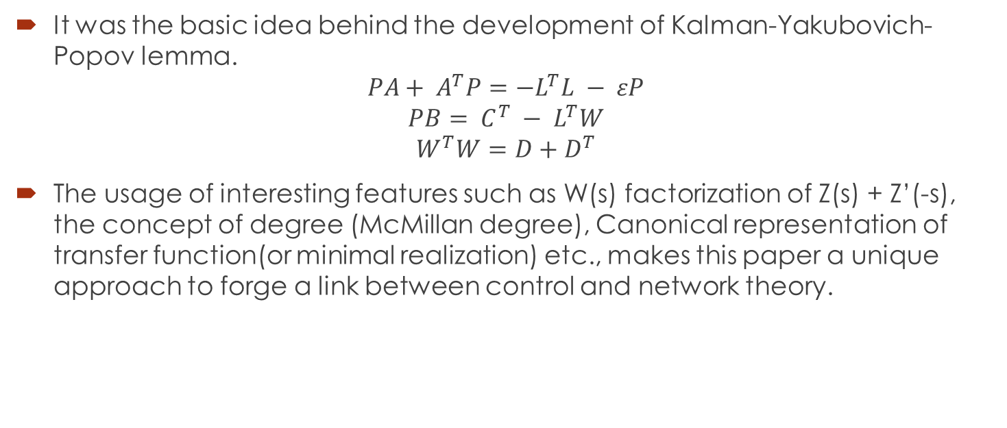
Future Scope:
It was the basic idea behind the development of Kalman-Yakubovich-Popov lemma.
$$PA+ A^{T}P=−L^{T}L − εP$$
$$PB= C^{T} − L^{T}W$$
$$W^{T}W=D+D^{T}$$
The usage of interesting features such as W(s) factorization of Z(s) + Z’(-s), the concept of degree (McMillan degree), Canonical representation of transfer function(or minimal realization) etc., makes this paper a unique approach to forge a link between control and network theory.

Slide 19
Thank You

